Slide 1


TRACEFINDER – FORENSIC SCANNER
IDENTIFICATION SYSTEM
PRESENTED BY : JISHNU A S

Slide 2


OVERVIEW
WORKFLOW
OUTPUT
RESULT AND DISCUSSION
FUTURE WORK
CONCLUSION
INTRODUCTION
PROBLEM STATEMENT
OBJECTIVES
METHODOLOGY
TECHNOLOGY USED

Slide 3


INTRODUCTION
Scanned documents are an integral part of modern digital communication in legal, academic, and organizational environments. During the scanning process, each scanner device introduces subtle hardware-dependent artifacts due to variations in sensors, optics, and illumination mechanisms. Although these artifacts are not visible to the human eye, they remain embedded within the scanned image.
Forensic analysis of these hidden patterns enables the identification of the scanner device used to digitize a document. The TraceFinder project focuses on leveraging image processing and machine learning techniques to analyze these scanner-specific characteristics and support reliable document source identification.

Slide 4

PROBLEM STATEMENT
How might we determine the scanner device used to generate a scanned document when scanner metadata is unavailable?
How might we extract and analyze scanner-specific patterns that are imperceptible to human observation?
How might we develop a practical and accessible system for scanner source identification in forensic applications?

Slide 5


OBJECTIVE
To analyze scanned document images for scanner-dependent artifacts
To build machine learning and deep learning models for scanner classification
To support multiple scanner devices and scanning resolutions
To assess system performance using standard evaluation metrics
To deploy a usable application for forensic scanner identification

Slide 6
METHODOLOGY
Data Collection and Preprocessing
Acquisition of scanned images from multiple scanner models
Use of different document types including flatfield and printed documents
Inclusion of scans at varying resolutions
Grayscale conversion, resizing, and normalization of images
Feature Extraction and Classical Modeling
Extraction of noise-based scanner artifacts
Statistical, frequency-domain, and texture feature computation
Training of Random Forest and Support Vector Machine classifiers

Slide 7
METHODOLOGY
Deep Learning-Based Modeling
Design and training of a Convolutional Neural Network
Image resizing and data augmentation for improved learning
Optimization using Adam optimizer and categorical cross-entropy loss
System Deployment
Integration of trained models into a Streamlit application
Implementation of real-time image upload and prediction
Storage and export of prediction results

Slide 8
TECHNOLOGY USED
Python – Application development and model implementation
OpenCV – Image preprocessing operations
NumPy & Pandas – Data manipulation and storage
Scikit-learn – Classical machine learning models
TensorFlow / Keras – Deep learning model development
Streamlit – Web-based deployment

Slide 9

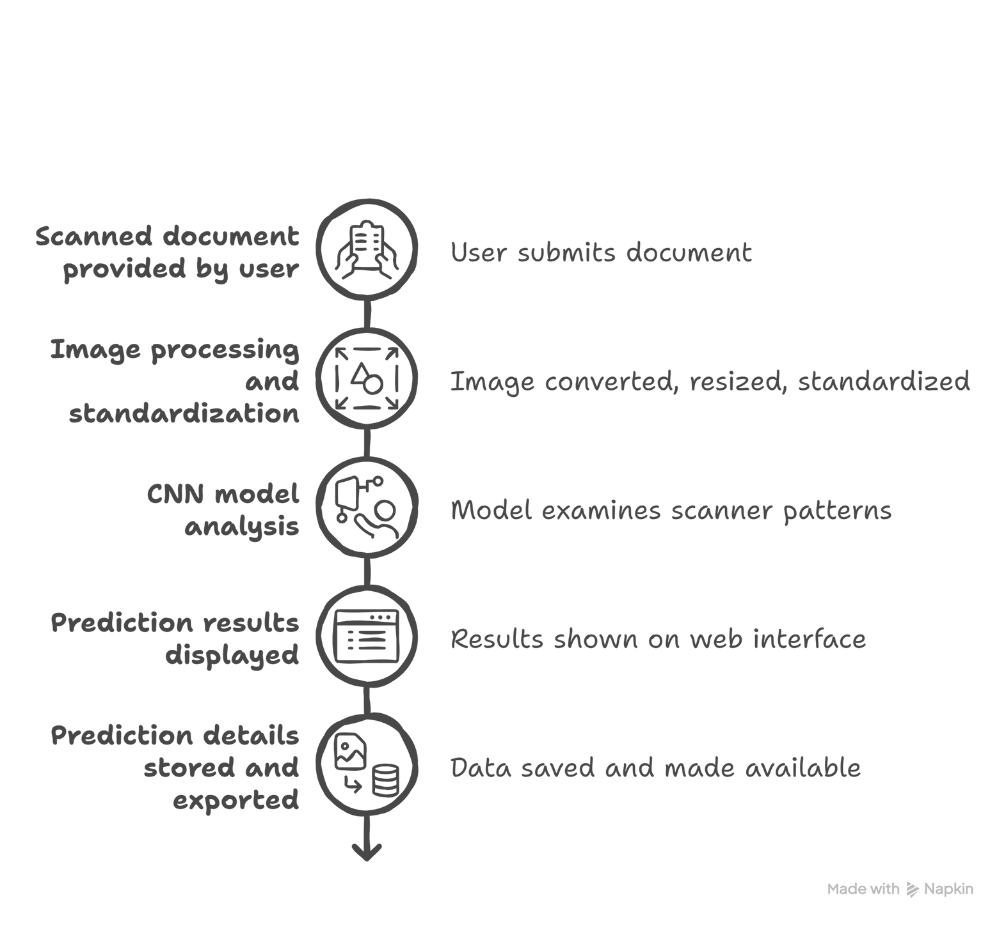
WORKFLOW

Slide 10
PERFORMANCE EVALUATION
The dataset was divided into training and evaluation sets to assess model performance
Multiple evaluation metrics were used to measure classification effectiveness
Accuracy was used to determine overall scanner identification performance
Precision and recall were analyzed to study class-wise prediction behavior
F1-score was used to balance precision and recall across scanner classes
Confusion matrices were examined to identify misclassification patterns
Performance of classical machine learning models was compared with the CNN model
The evaluation confirmed consistent and reliable scanner identification results

Slide 11

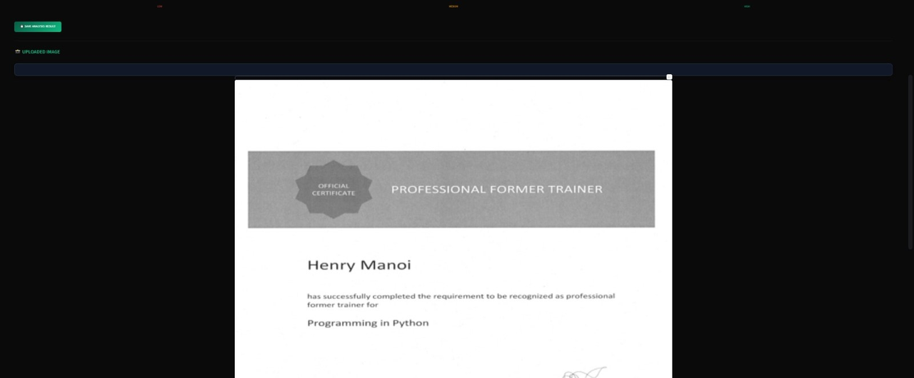

OUTPUT

Slide 12


OUTPUT

Slide 13
RESULTS AND FUTUREWORKS
Results
High classification accuracy achieved using classical ML models
CNN model demonstrated effective learning of scanner-specific features
Reliable performance observed across different scanner devices
Successful deployment of an end-to-end forensic identification system
Future Works
Inclusion of additional scanner models and datasets
Testing on real-world scanned documents
Integration of advanced forensic noise analysis techniques
Further optimization of deep learning architecture
Scalable cloud-based deployment

Slide 14


CONCLUSION
The TraceFinder project demonstrates the effectiveness of machine learning and deep learning techniques in forensic scanner identification. By analyzing subtle scanner-dependent artifacts in scanned documents, the system enables accurate source classification. The deployed application provides a practical solution for real-world forensic document analysis and highlights the growing role of artificial intelligence in digital forensics.

Slide 15

THANK YOU

